Slide 1


Mobile Programming Course Fall 2021 Mohamad ChamanMotlagh Amirhosseir Hedielou Moein NasrKhademli Course lecturer: Dr. Sajad Shirali-Shahreza CE Department, Amirkabir University of Technology
3D illustrator

Slide 2
TABLE OF CONTENTS
1.
2.
3.
Motive & Purpose
Basic workflow of our application and the solutions we provide.
Why us?
A look at our competitors.
Background
How we came to such a decision.

Slide 3
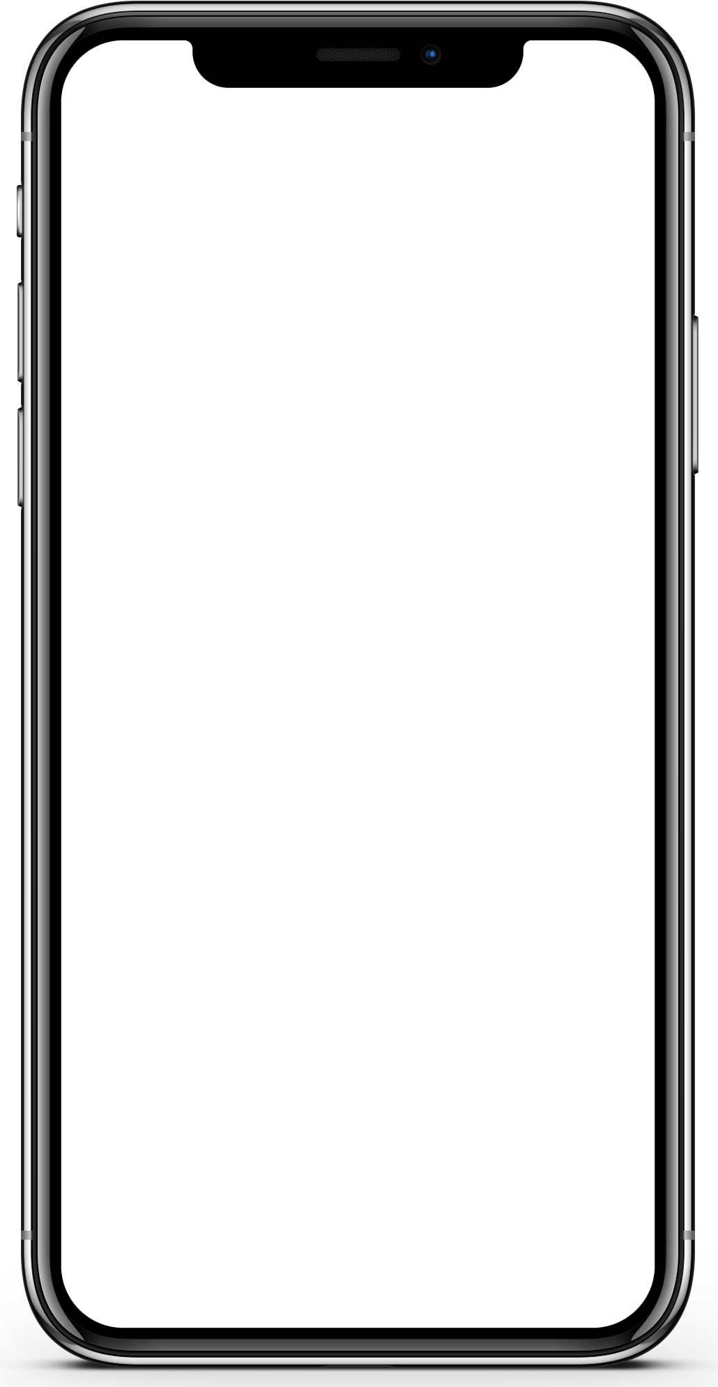
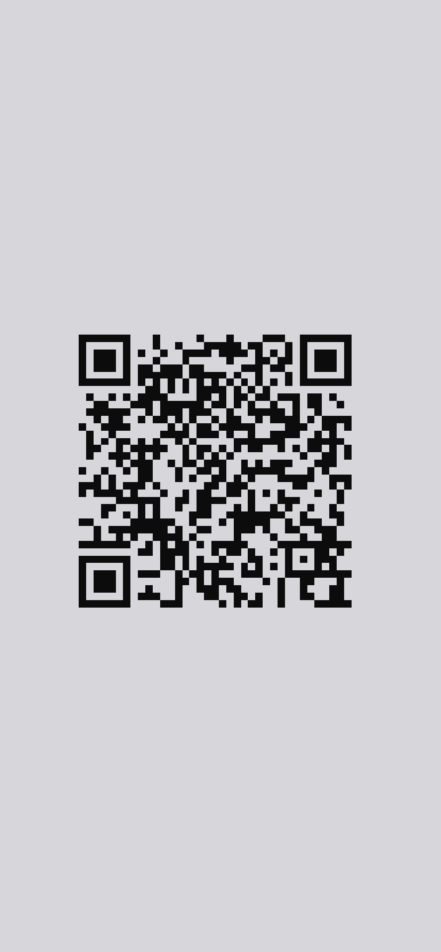

Simplified Workflow
Authentication
Search
Process and Send

Slide 4
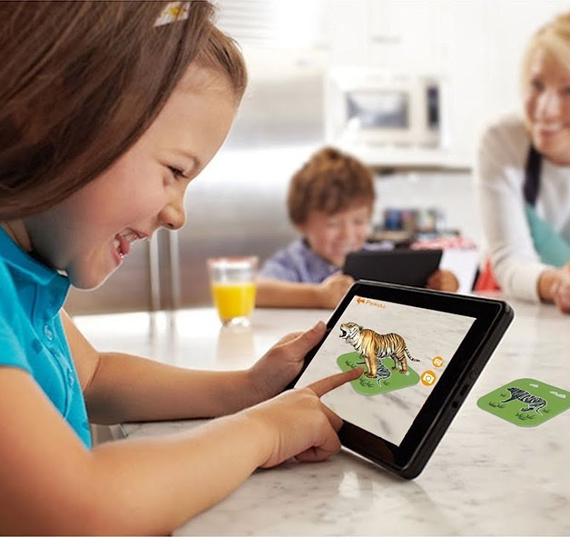
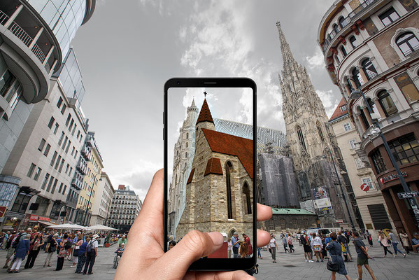
Use Cases

Slide 5

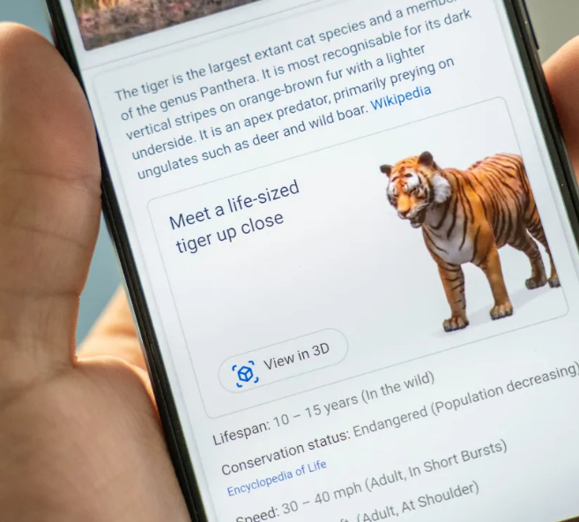
Market

Slide 6
THANKS!
DO YOU HAVE ANY QUESTION?

